Slide 1
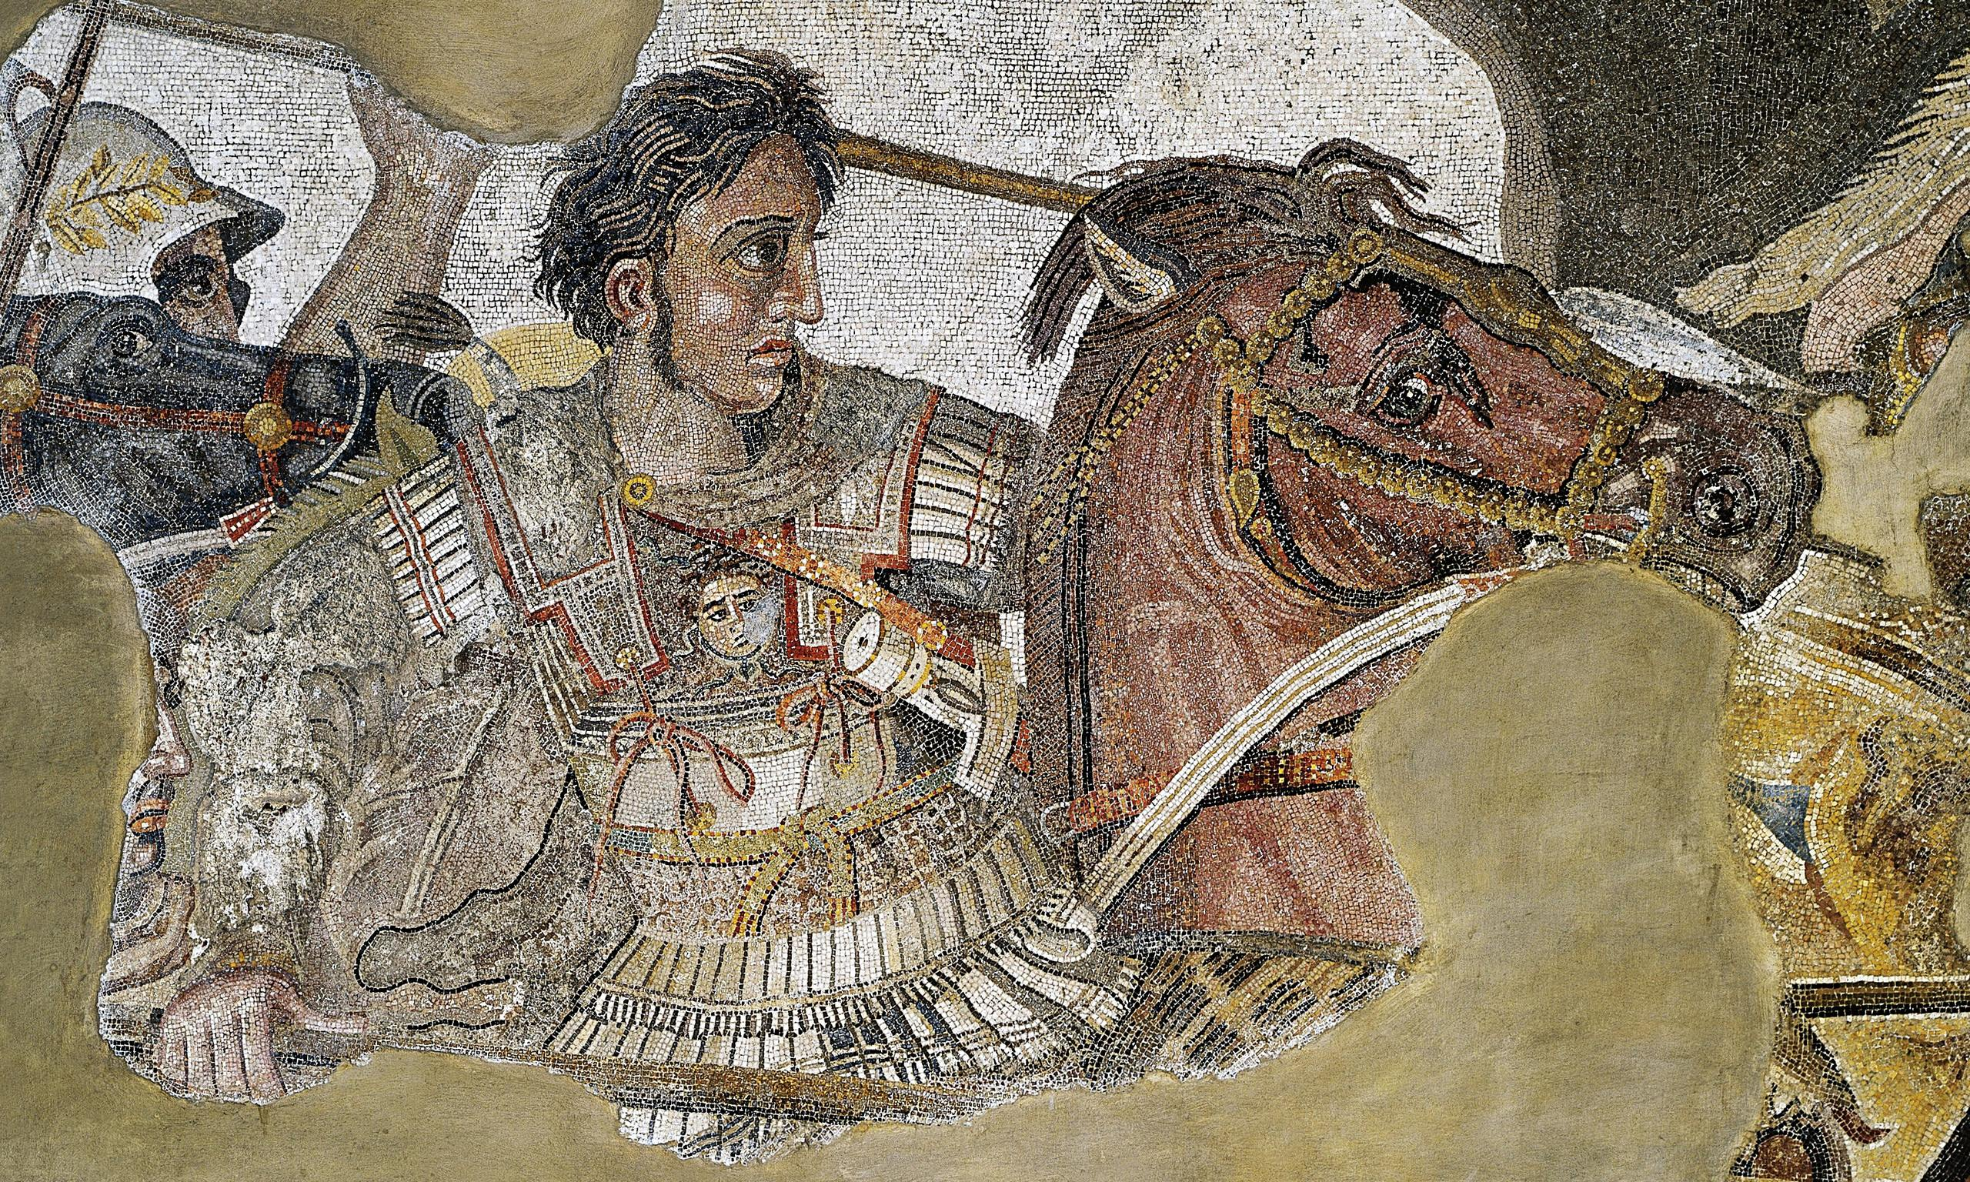
Legacy of ATG
Goal/s:
Describe the legacy of alexander the great
Week 3 Lesson 1 – unit 2
Ms Barrie

Slide 2
The Hellenistic Age
The Marriage of East & West
Alexander the Great ushered in the Hellenistic Age – A period where Greek influence could be found throughout the known world!

Slide 3
Alexandria
Founded by ATG in 332 BC
Designed to be a model city that would reflect splendour of ATG
Military stronghold/naval base
Rapidly became trading and admin centre of Egypt under the greeks
After ATG’s death, it came under Egyptian control and continued to flourish
Within 100 years, Alexandria had become the leading city of the world and the centre of Greek cultural life

Slide 4
So what did he do?
Alexander the Great's legacy is both far reaching and profound.

Slide 5
1. Conquests
1. His father was able to unite the Greek city-states, and Alexander destroyed the Persian Empire forever. More importantly, Alexander's conquests spread Greek culture, also known as Hellenism, across his empire.

Slide 6
2. Hellenistic Age
2. In fact, Alexander's reign marked the beginning of a new era known as the Hellenistic Age because of the powerful influence that Greek culture had on other people. Without Alexander's ambition, Greek ideas and culture might well have remained confined to Greece.

Slide 7
3. Personality
3. Many historians see Alexander the Great in a different light. Although Alexander was both intelligent and handsome, he also had a darker side.
He possessed a ferocious temper and from time to time would arbitrarily murder close advisors and even friends. Also, toward the end of his many campaigns, he senselessly slaughtered thousands whose only crime was being in his way.

Slide 8
4. Spread of ideas
4. Alexander made Babylonia the capital of his Empire
He married one of Darius’ daughters and “encouraged” 10,000 of his soldiers to take Persian wives
He died the following year at 33 before he could produce an heir and his kingdom was divided among 3 of his generals

Slide 9
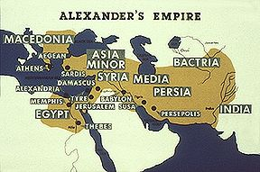
Antigonus
Seleucus
Ptolemy

Slide 10
ACTIVITY
Read through the information sheet about the Hellenistic Kingdom.
Take notes in your book.

Slide 11
SUMMARY:
Describe what is meant by the ‘Hellenistic Era’.

